Slide 1

Telecom Domain Insights

Slide 2
Problem Statement Points
1. Decline in Performance After 5G Launch
After launching 5G services in May 2022, AtliQo observed a drop in active users and slower revenue growth, which raised concerns for management.
2. Need for Pre vs Post Analysis
The company wants a comparative analysis of key KPIs (before and after 5G launch) to understand performance changes.
3. Unclear Impact of 5G Plans
It is uncertain whether the new 5G plans positively or negatively impacted customer behavior, usage, and revenue.

Slide 3
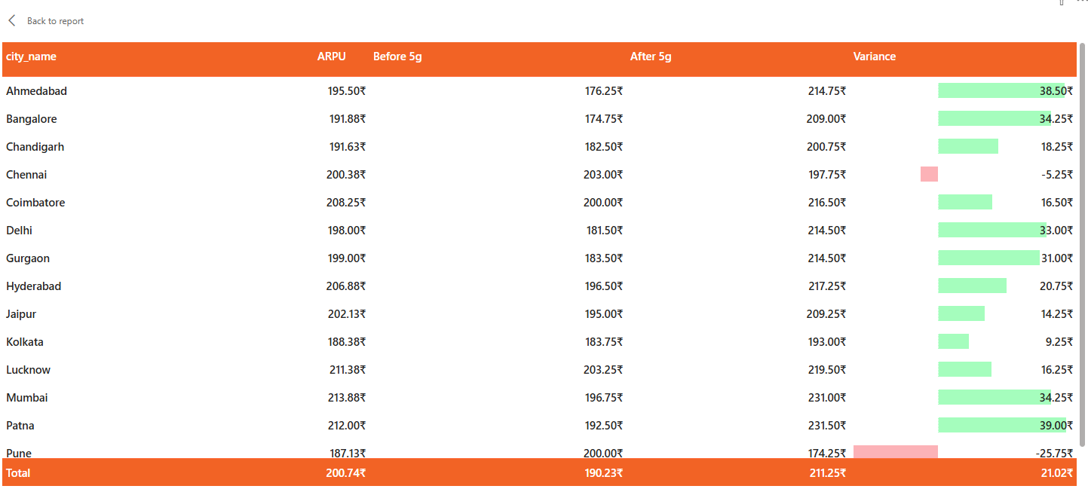
What Went Wrong?
Prices are too high for customers of 5G

Slide 4
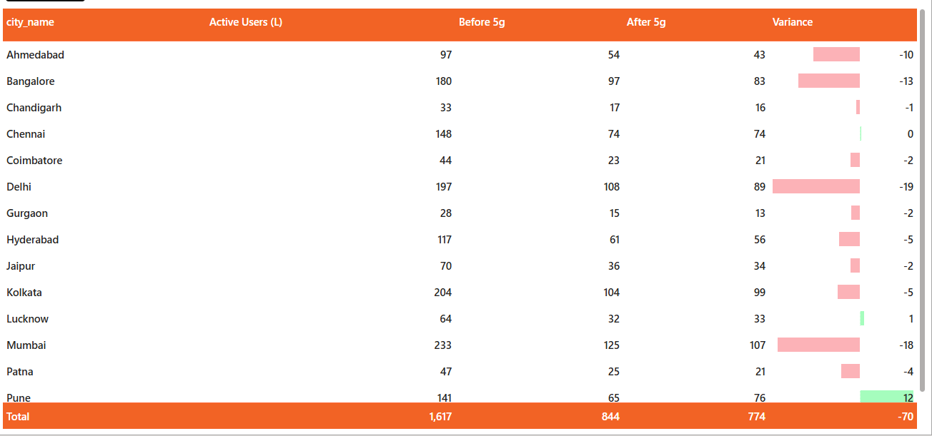
What Went Wrong?
Many users left after 5G launch
Big cities like Delhi and Mumbai lost the most users

Slide 5
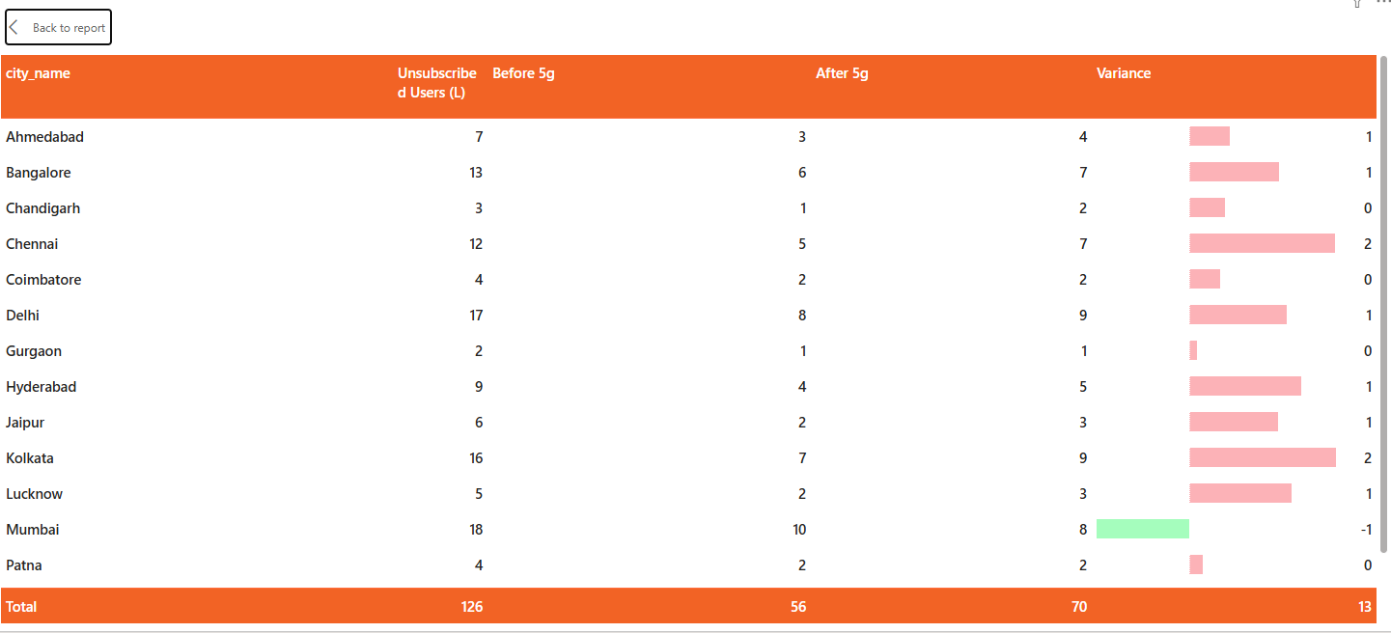
What Went Wrong?
Unsubscribed users increased by 13 Lakhs post-5G. This is a clear signal of customer dissatisfaction with the new service or its cost.

Slide 6
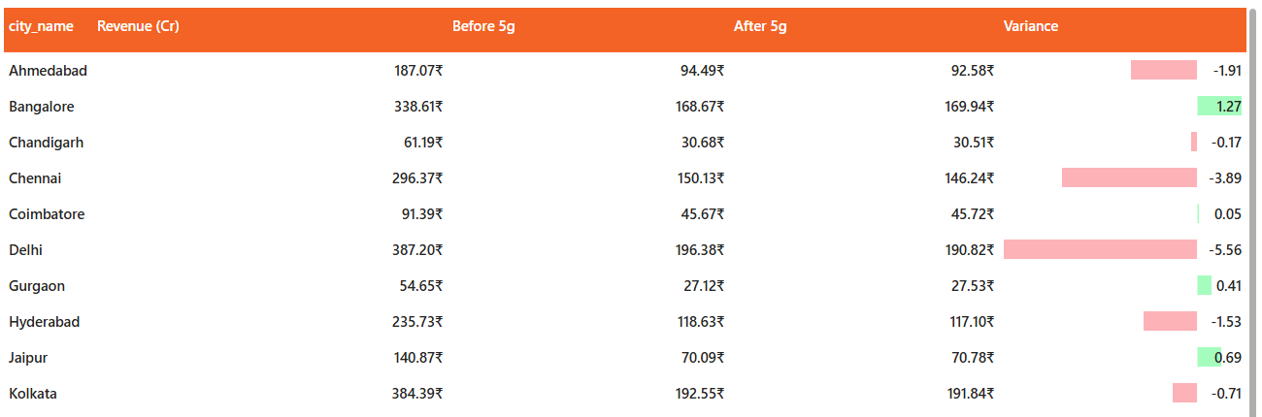
What Went Wrong?
Revenue loss is mainly observed in Delhi, Chennai, and Ahmedabad.

Slide 7
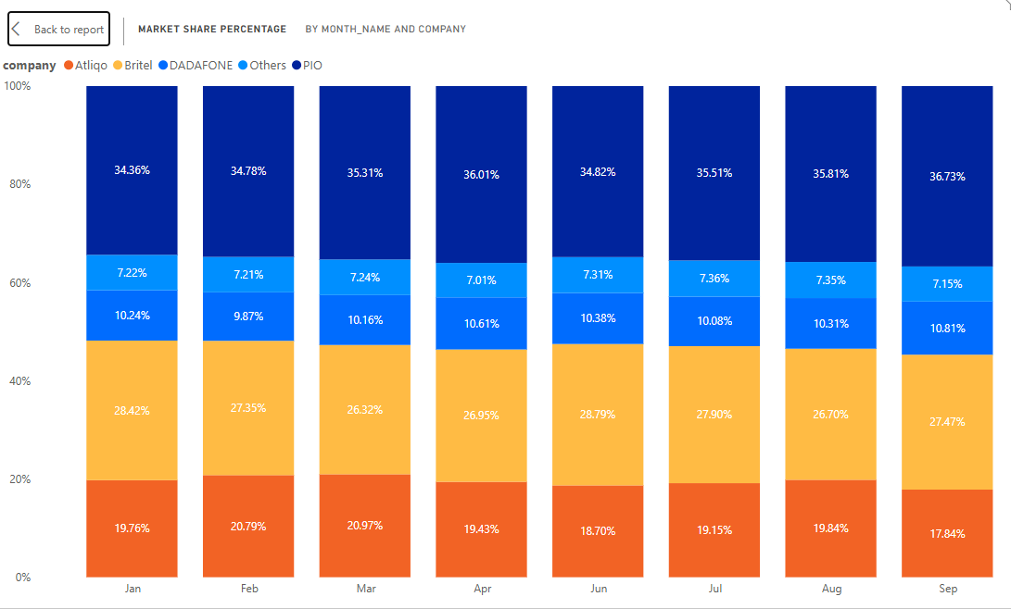
What Went Wrong?
AtliQo’s market share dropped from a peak of nearly 21% in March to 17.84% by September.
Market share dropped by around 3%

Slide 8
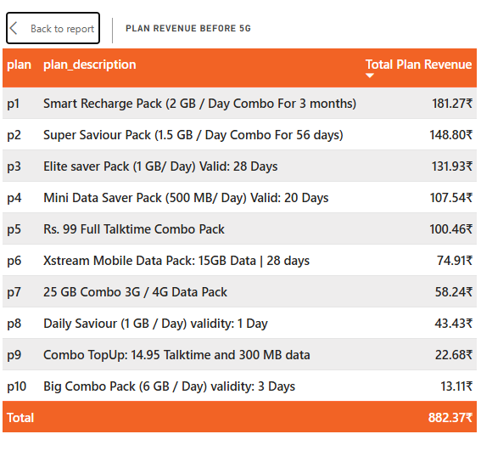
Plan Insights
The Smart Recharge Pack (P1) is the top earner, bringing in 181.27₹.
Small daily and top-up packs (P8, P9, P10) contribute the least to total earnings.
Plans with 1GB to 2GB per day are the most popular choices for customers.

Slide 9
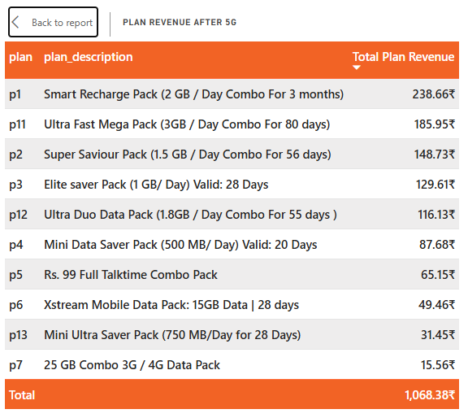
Plan Insights
The Smart Recharge Pack (P1) remains number one, with revenue jumping to 238.66₹.
The Ultra Fast Mega Pack (P11) is a strong new entry, immediately becoming the second-highest earner.
New high-data plans (P11, P12) are successfully replacing older, lower-value options.
Revenue from basic plans like the Rs. 99 pack (P5) fell sharply as users moved to 5G tiers.

Slide 10
Recommendations for Growth
Introduce mid-tier plans (between P1 and P11) to win back the millions of users who left for cheaper competitors.

Slide 11
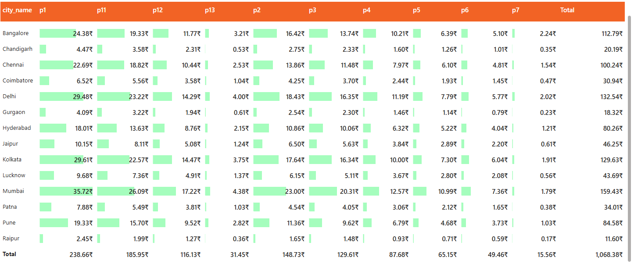
Recommendations for Growth
Pune was the only city to gain massive users (+12L). Investigate if Pune had special promotions or better network stability and replicate that model in Delhi and Mumbai.

Slide 12
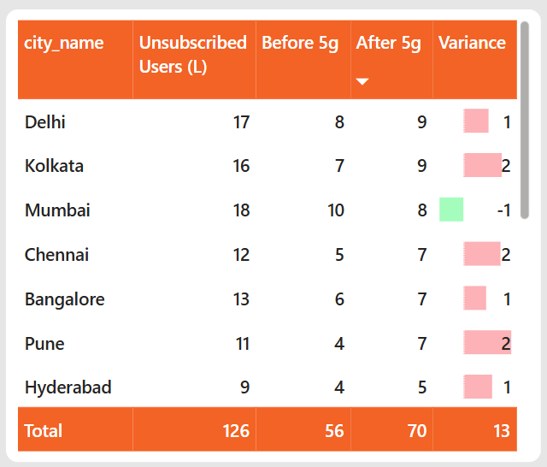
Recommendations for Growth
Try to bring back users who left
Target the 13 lakh unsubscribed users
Offer discounts or special deals
Give cheaper 5G plans or device offers
Make it easy and attractive for them to return

Slide 13
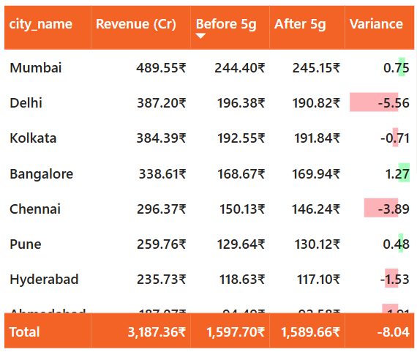
Recommendations for Growth
Delhi and Mumbai drive the most revenue value, offer loyalty rewards or bundled 5G services (like free streaming) to stop existing high-value users from switching to PIO.

Slide 14
Final Recommendation
Improve 4G/5G Bridge
Ensure users who don't have 5G phones yet aren't forced onto expensive plans. Keep strong 4G options available to maintain the total active user count.

